Slide 1
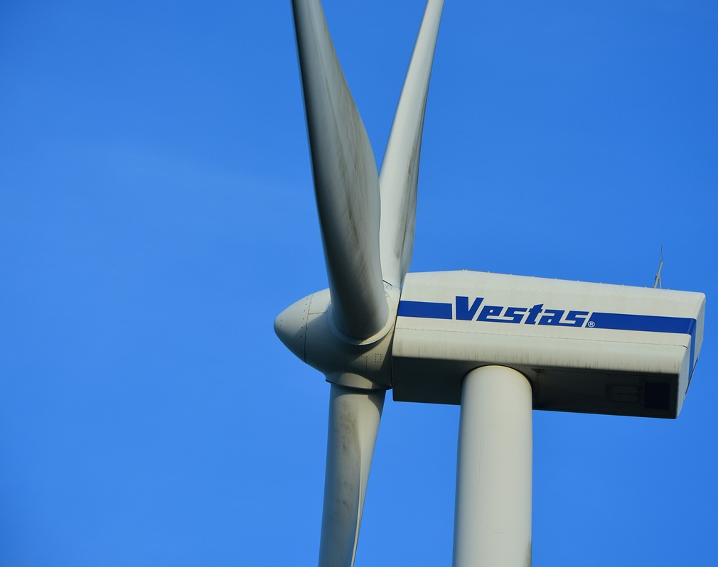
Offshore Wind Turbine Power Prediction and Wind Capacity Analysis Using LIDAR
Team:
Aditya Garapati
Chase Henderson
Brian Waite
Carl Walenciak
Advisor:
Prof. Blanchard

Slide 2
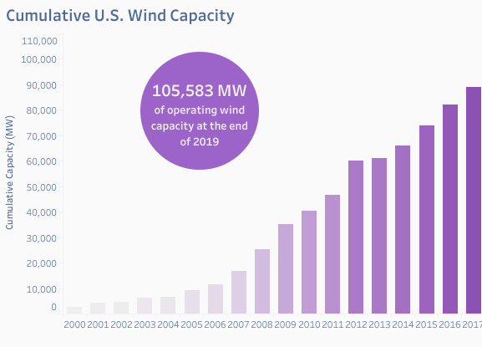
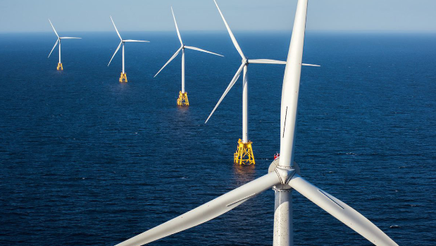
U.S. Wind Industry
Potential Wind Capacity in U.S. (at 80m turbine hub height) is 10,640,000MW.
Only 1 Offshore U.S. wind farm in operation today.
30 MW farm at Block Island, RI
By 2026, 9,112 MW of installed offshore wind capacity anticipated.
https://www.awea.org/Awea/media/Resources/Fact%20Sheets/Offshore-Fact-Sheet.pdf

Slide 3

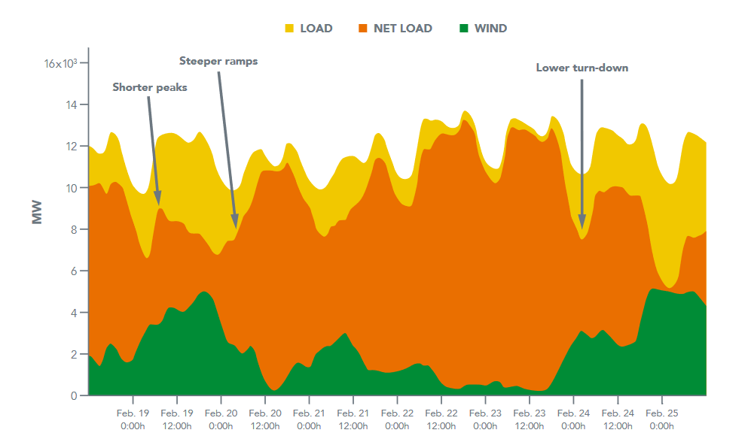
Challenge of Wind Integration
U.S. Energy Grid is in continuous balance between generation and load.
Wind variability directly impacts the need for conventional power plants to shape capacity in response.
Causes additional wear on equipment, inability to match load, affects cost return model of conventional plants.
https://www.nrel.gov/docs/fy14osti/61721.pdf

Slide 4
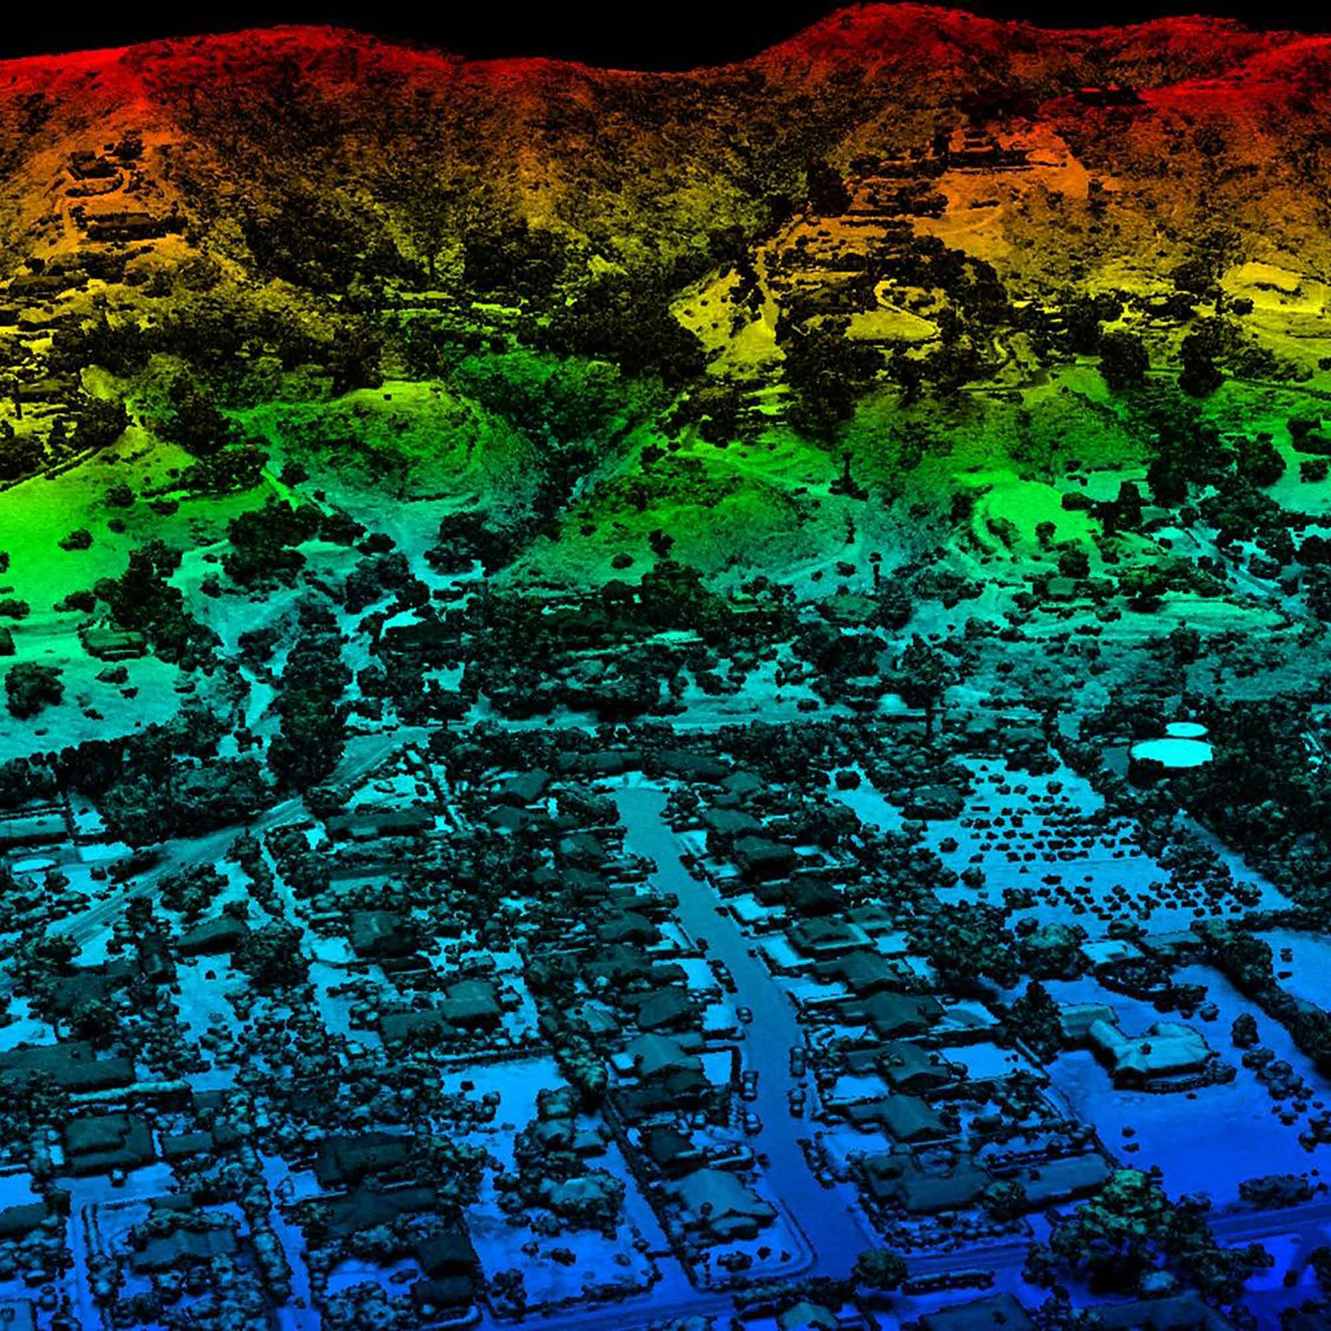
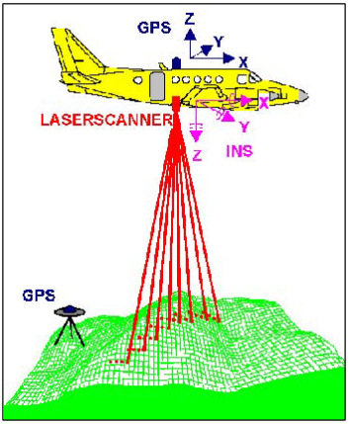
Light Detection and Ranging (LIDAR) Technology
Similar to RADAR or SONAR, but uses laser light pulses to measure distance to objects.
Fine resolution, high accuracy measurements.
Commonly used in terrain mapping and survey.
https://coast.noaa.gov/data/digitalcoast/pdf/lidar-101.pdf
https://www.harris.com/solution/geiger-mode-lidar

Slide 5
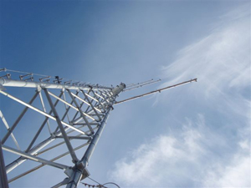
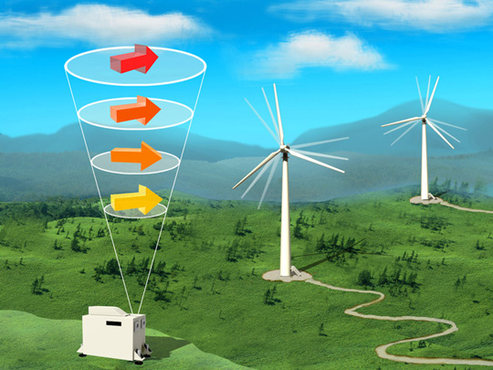
What does LIDAR have to do with wind?
Traditional wind survey and sustained measurement performed with meteorological “met” towers.
Expensive and fixed position.
Not feasible for offshore wind.
LIDAR units are small, portable, and do not require significant investment.
Measure at multiple heights above sensor simultaneously and capture direction.
https://orgnew-www.mitsubishielectric.com/news/2014/0528_zoom_01_print.html

Slide 6
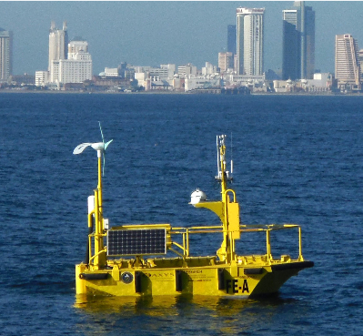
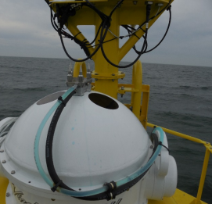
What is Buoy LIDAR Data?
Pacific Northwest National Labs (PNNL) in support of U.S. Department of Energy (DOE)
Buoy collects comprehensive meteorological and oceanographic data characterize offshore wind energy.
LIDAR – LIght Detection And Ranging
Data available from 3 deployments.
https://wind.pnnl.gov/lidarbuoyloanprogram.asp
https://wind.pnnl.gov/pdf/Example_Monthly_Report.pdf

Slide 7
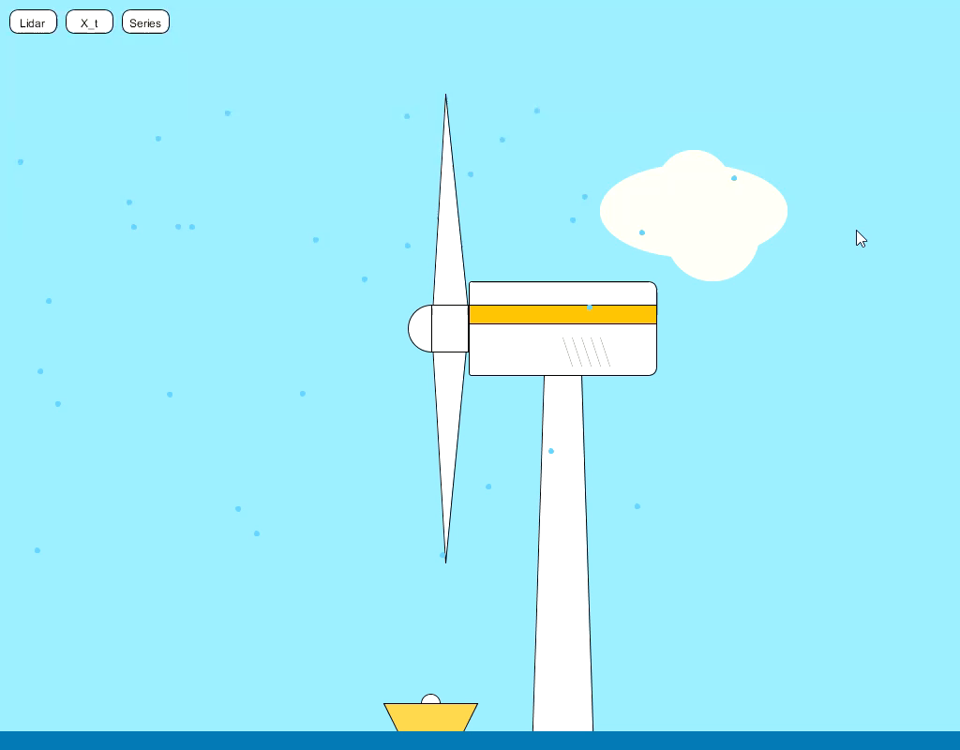

Slide 8
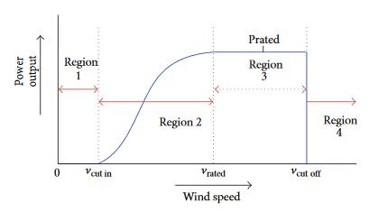
Research Objectives
Explore statistical time series, machine learning, and appropriate ensemble methods to enable forecasting of wind strength and, as a result, power availability given historic wind LIDAR data.
Time horizons:
Immediate “at turbine” power prediction: 5-10 minutes
12 hours: To allow planning for energy markets and overall system operation.
Explore visualizations of potential use.
P = ρ A v³ / 2

Slide 9



Mentors and Outreach
Prof. Yu Ding
Texas A&M
Contacted and offered to be a sounding board.
Spoken with team at PNNL operating the BUOY LIDAR system.
Dr. Sadler doing “lightweight” mentoring of our timeseries work
Note: Display does not indicate endorsement of our work or findings by individuals or their institutions.

Slide 10
Data
Available from 3 buoy deployments (2 completed, 1 ongoing)
Offshore Virginia (2014-2016)
Offshore New Jersey (2015-2017)
Offshore Massachusetts (2019-2020)
Records include:
LIDAR data
Temp
Pressure
Relative Humidity
Wave height and period
Sub-surface current information
Collected at 1-second intervals.

Slide 11
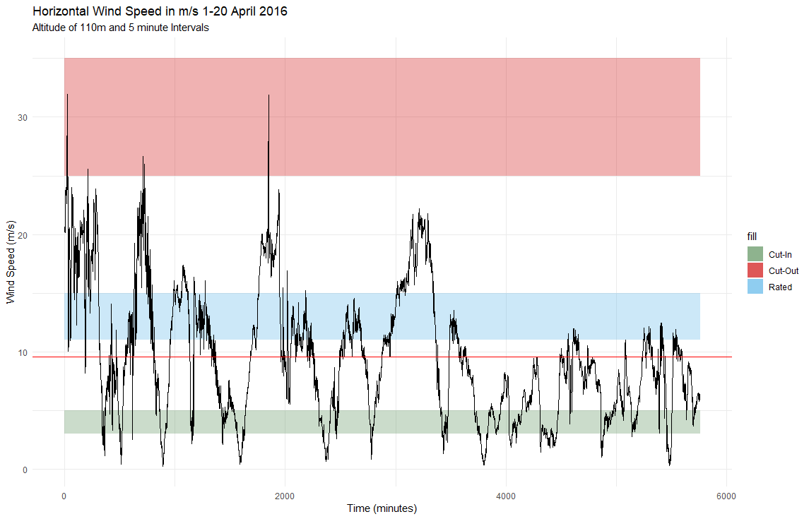
20 days of buoy LIDAR wind speed data at 110m height
X_{bar}

Slide 12
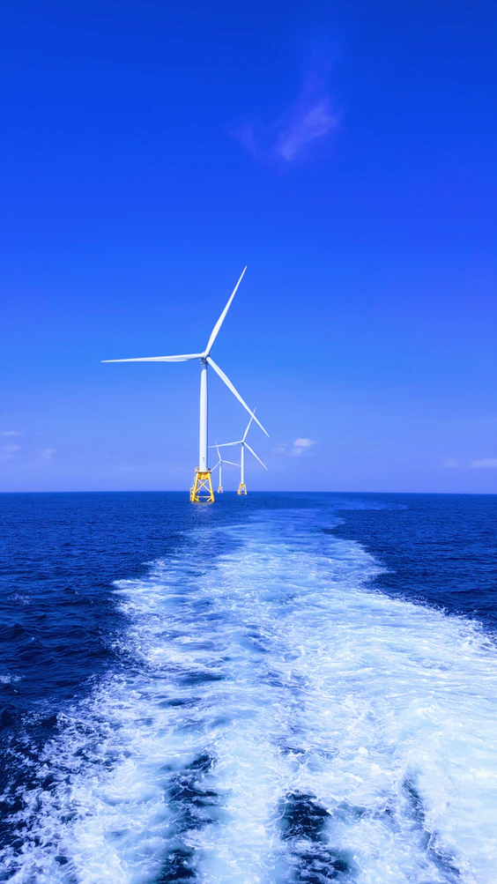
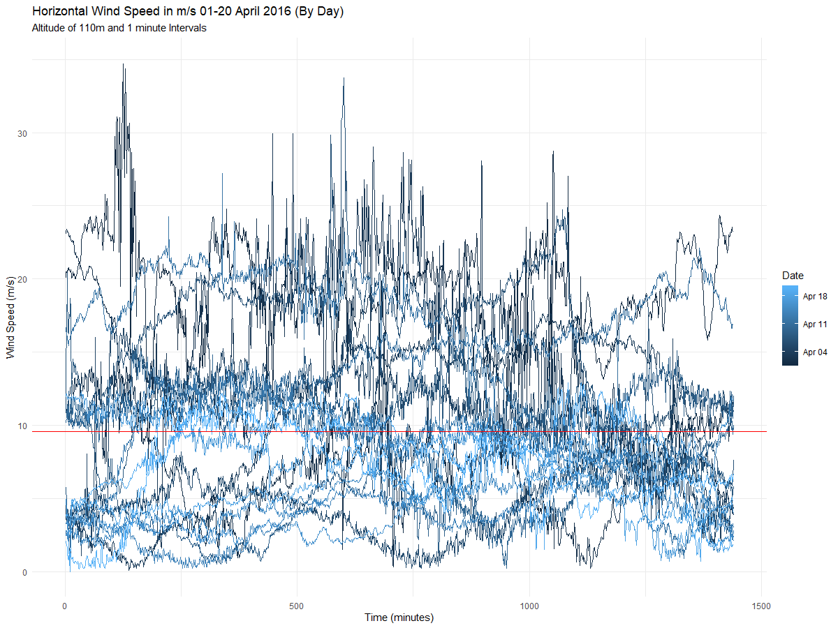
20 days of Buoy LIDAR data.

Slide 13
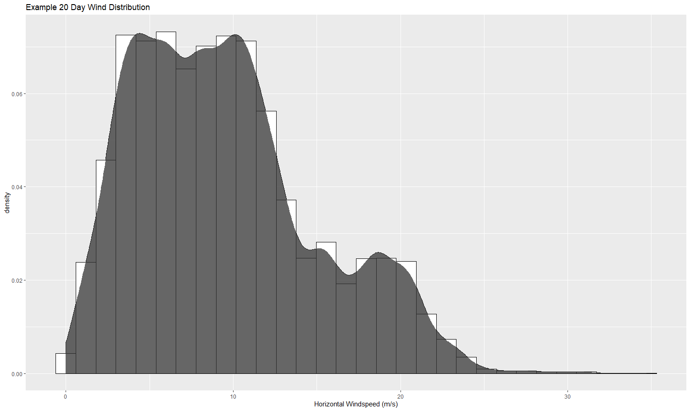
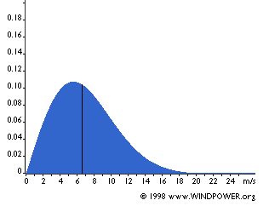
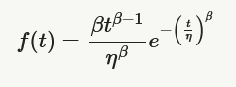
Weibull Distribution and Wind
Wind values generally follow the Weibull Distribution (inset).
Prior to analysis we must fit the parameters of this distribution and standardize / normalize the wind values.

Slide 14
Modeling Techniques (Non Linear)
Long Short Term Memory Models (LSTM)
RNN
. GBM
Compare and contrast between these non Linear models and traditional statistical models like ARIM for accuracy

Slide 15
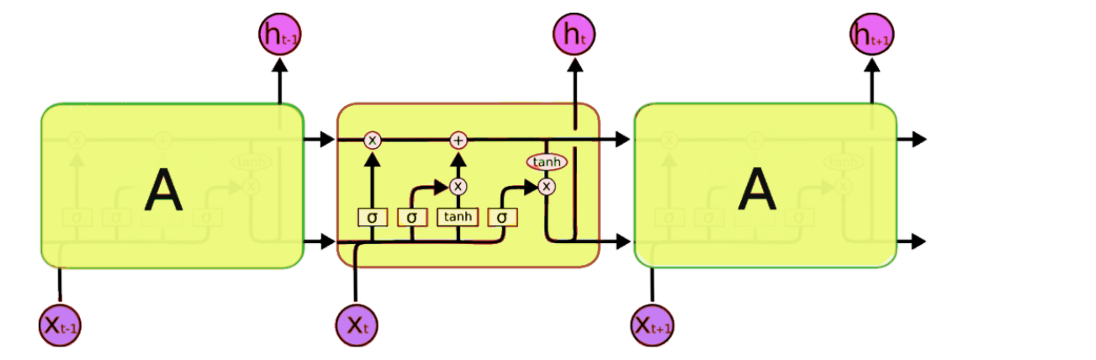
LSTM models
Soure : Analytical vidaya

Slide 16
Literature / Research Review (and growing)
1. American Wind Energy Association: Wind Energy Facts at a Glance (2020), http://www.awea.org/Resources/Content.aspx?ItemNumber=5059
2. Bird, L., Milligan, M., Lew, D.: Integrating variable renewable energy: Challenges and solutions . https://doi.org/10.2172/1097911
3. Ding, Y.: Data Science for Wind Energy. Chapman and Hall/CRC (Jun 2019). https://doi.org/10.1201/9780429490972
4. DOE: A2e: BUOY, https://a2e.energy.gov/projects/buoy
5. Energy, D.o.E.O.o.E.E., Renewable: WINDExchange: U.S. Installed and Potential Wind Power Capacity and Generation (2020), https://windexchange.energy.gov/maps-data/321
6. Leosphere, The Role of LIDAR in offshore wind measurement. White Paper. (Nov 2017), https://www.lidar.gwu-group.de/files/2017_Leosphere_White_Paper_-The_role_of_Lidar_in_offshore_wind_measurement.pdf
7. Moore, D.J.: Oshore wind data., https://orsted.com/en/Our-business/Oshore-wind/Wind-Data
8. Pichugina, Y.L., R.M. Banta, W.A. Brewer, S.P. Sandberg, and R.M. Hardesty, 2012: Doppler Lidar–Based Wind-Profile Measurement System for Offshore Wind-Energy and Other Marine Boundary Layer Applications. J. Appl. Meteor. Climatol., 51, 327–349, https://doi.org/10.1175/JAMC-D-11-040.1

